Slide 1

Kotlin Coroutines and the Order of the Concurrency
by Artur Radiuk

Slide 2
Example problem
Submit order
Fetch offers for cart
Fetch user’s subscriptions
Fetch delivery methods
Fetch payment methods
Validate purchase
Place order

Slide 3
Example problem
What options do we have?

Slide 4
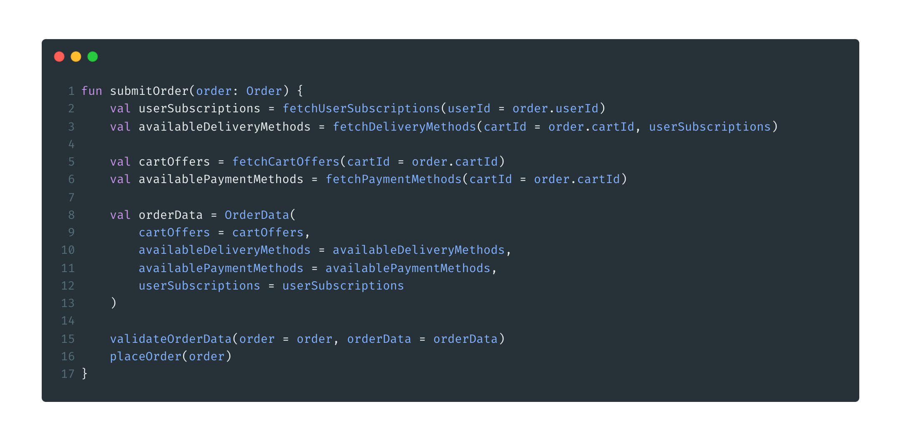
Synchronous solution

Slide 5
Synchronous solution
But how does it work?

Slide 6


Synchronous solution
customer-service
delivery-method-service
purchase-service
payment-service
shopping-cart-service

Slide 7


Synchronous solution
customer-service
delivery-method-service
purchase-service
payment-service
shopping-cart-service

Slide 8

Synchronous solution

Slide 9
Synchronous solution
customer-service
delivery-method-service
purchase-service
payment-service
shopping-cart-service

Slide 10
Synchronous solution
customer-service
delivery-method-service
purchase-service
payment-service
shopping-cart-service

Slide 11
Synchronous solution
customer-service
delivery-method-service
purchase-service
payment-service
shopping-cart-service

Slide 12
Synchronous solution

Slide 13
Synchronous solution
customer-service
delivery-method-service
purchase-service
payment-service
shopping-cart-service

Slide 14
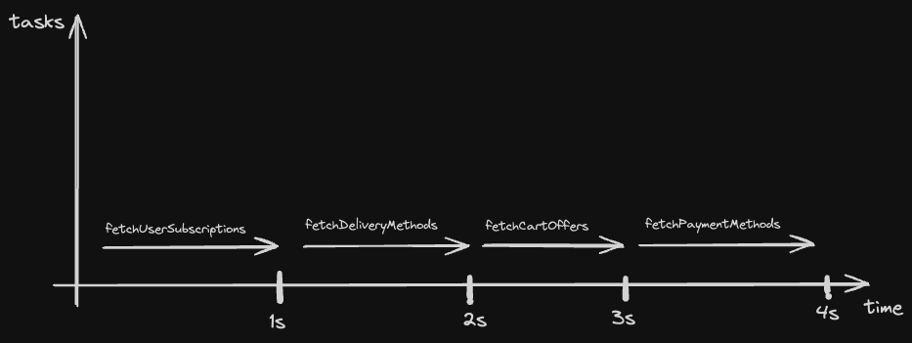
Synchronous solution

Slide 15
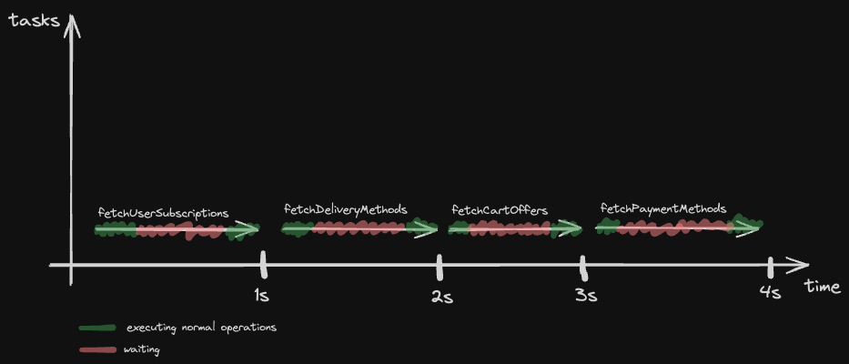
Synchronous solution

Slide 16
Synchronous solution
Maybe we can make it better?

Slide 17
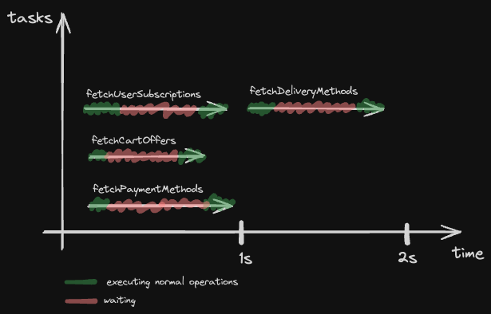
Desired non-blocking solution

Slide 18
Multithreading solution
What about multithreading?
threads, executors etc.

Slide 19

Multithreading solution

Slide 20
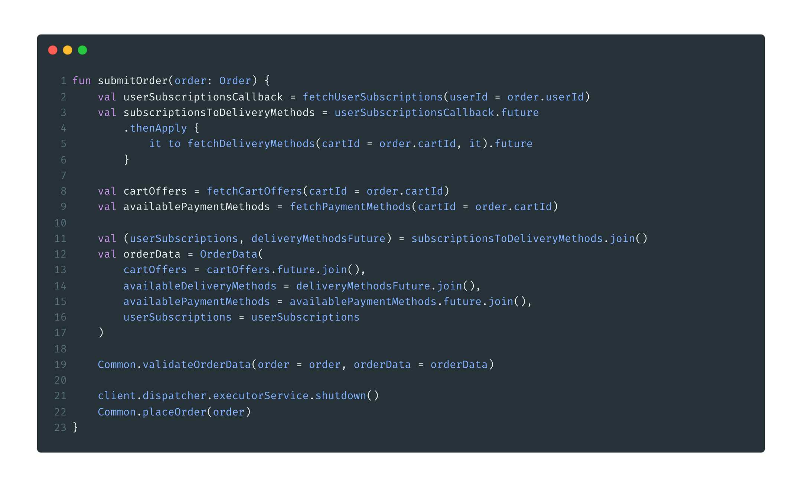
Callback solution

Slide 21
Callback solution
What about:
error handling?
cancelling?

Slide 22
Callback solution
Better, but:
Accidental complexity
Cancelling is hard
Error handling is hard

Slide 23
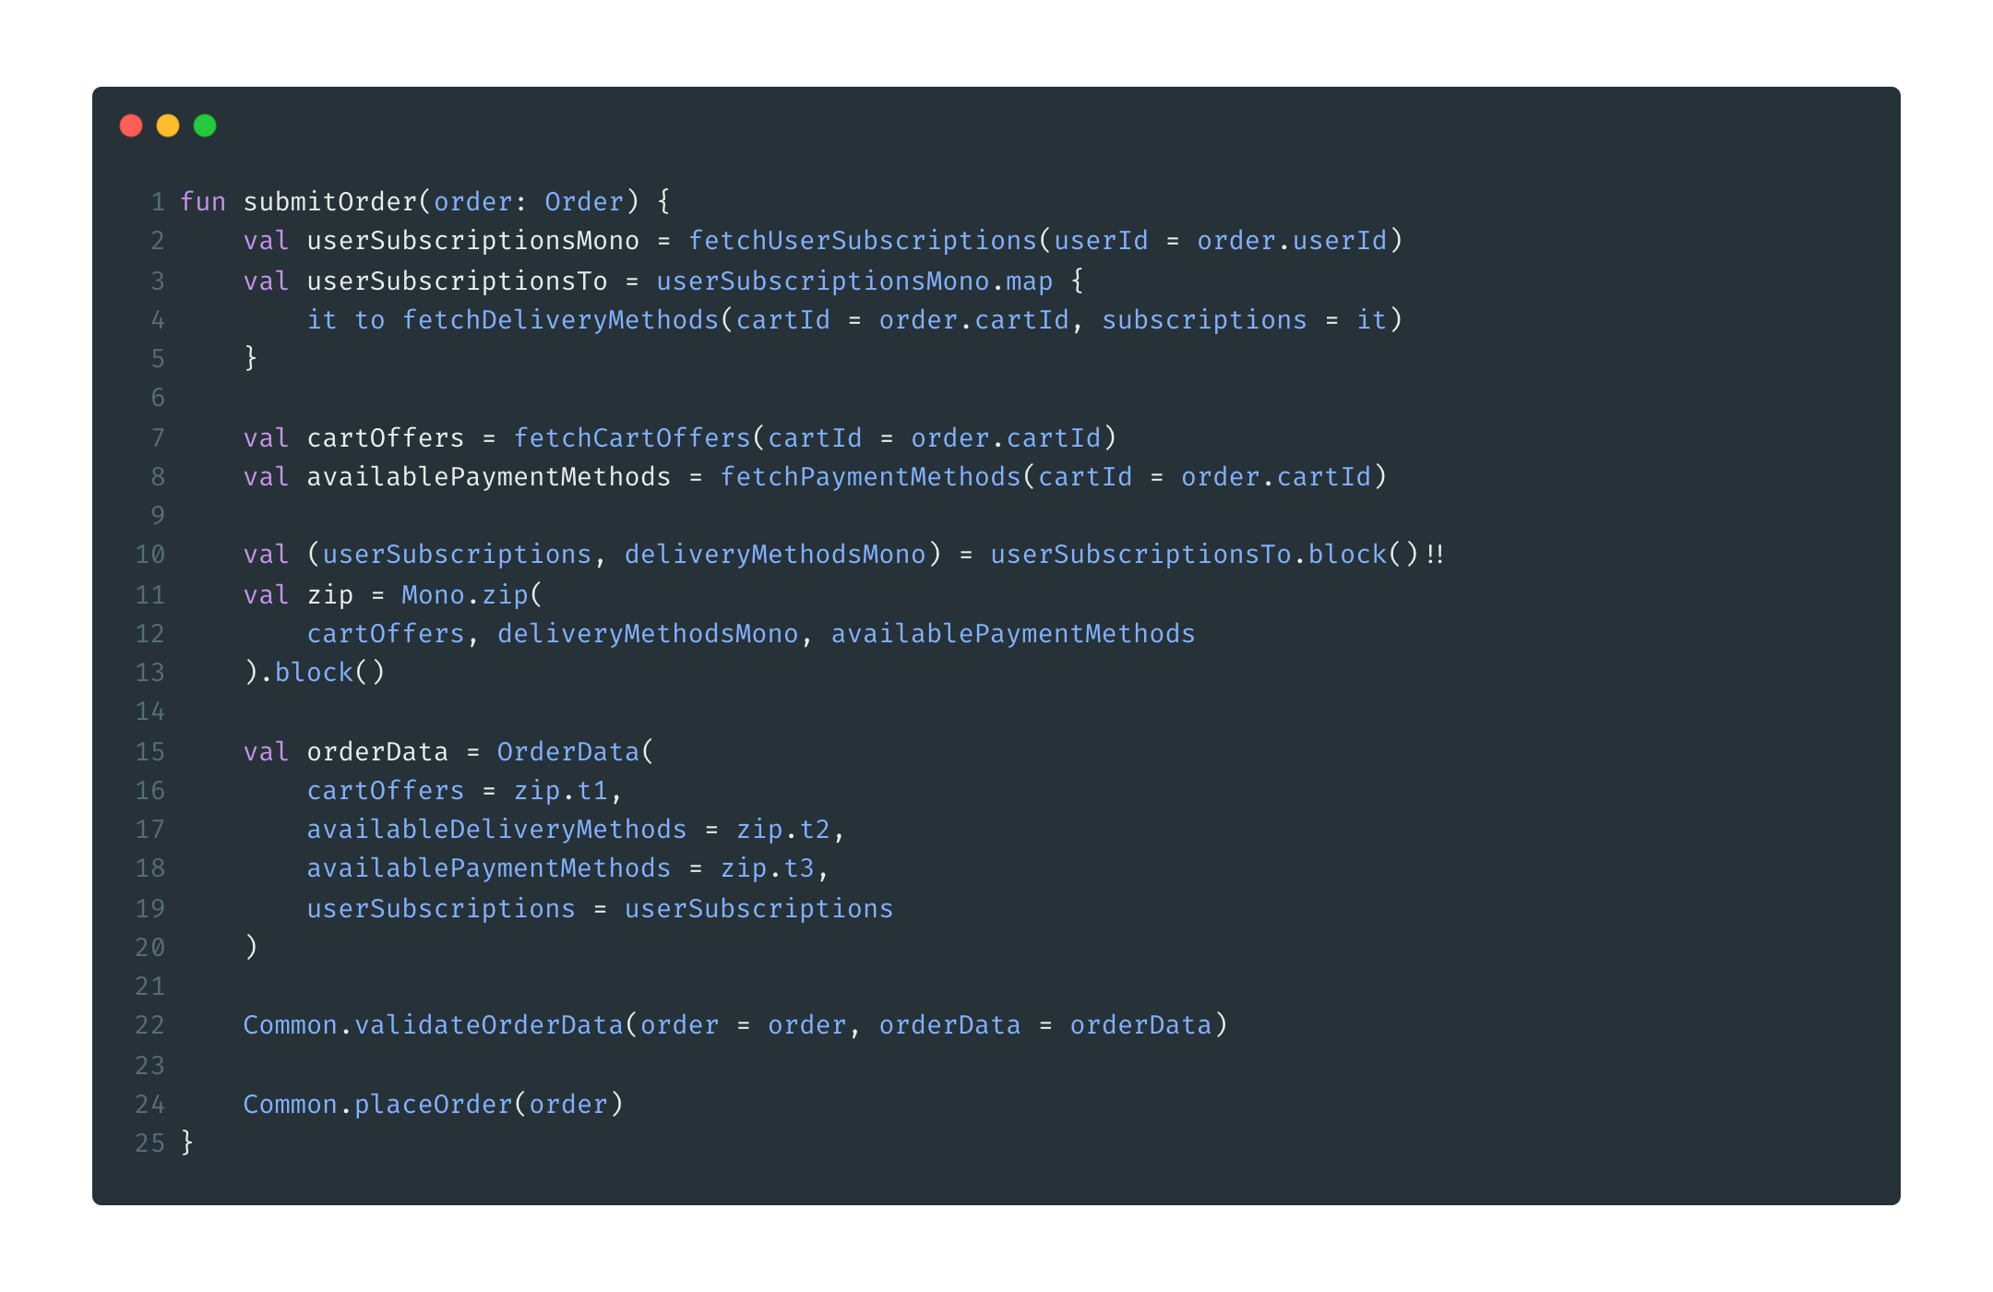
Reactor solution

Slide 24
Reactor solution
Event more better, but:
accidental complexity
external tool (versions, compatibility, inner implementation…)

Slide 25
Reactor solution
What about:
error handling?
cancelling?

Slide 26
Example problem
What if submit purchase must be asynchronous?

Slide 27
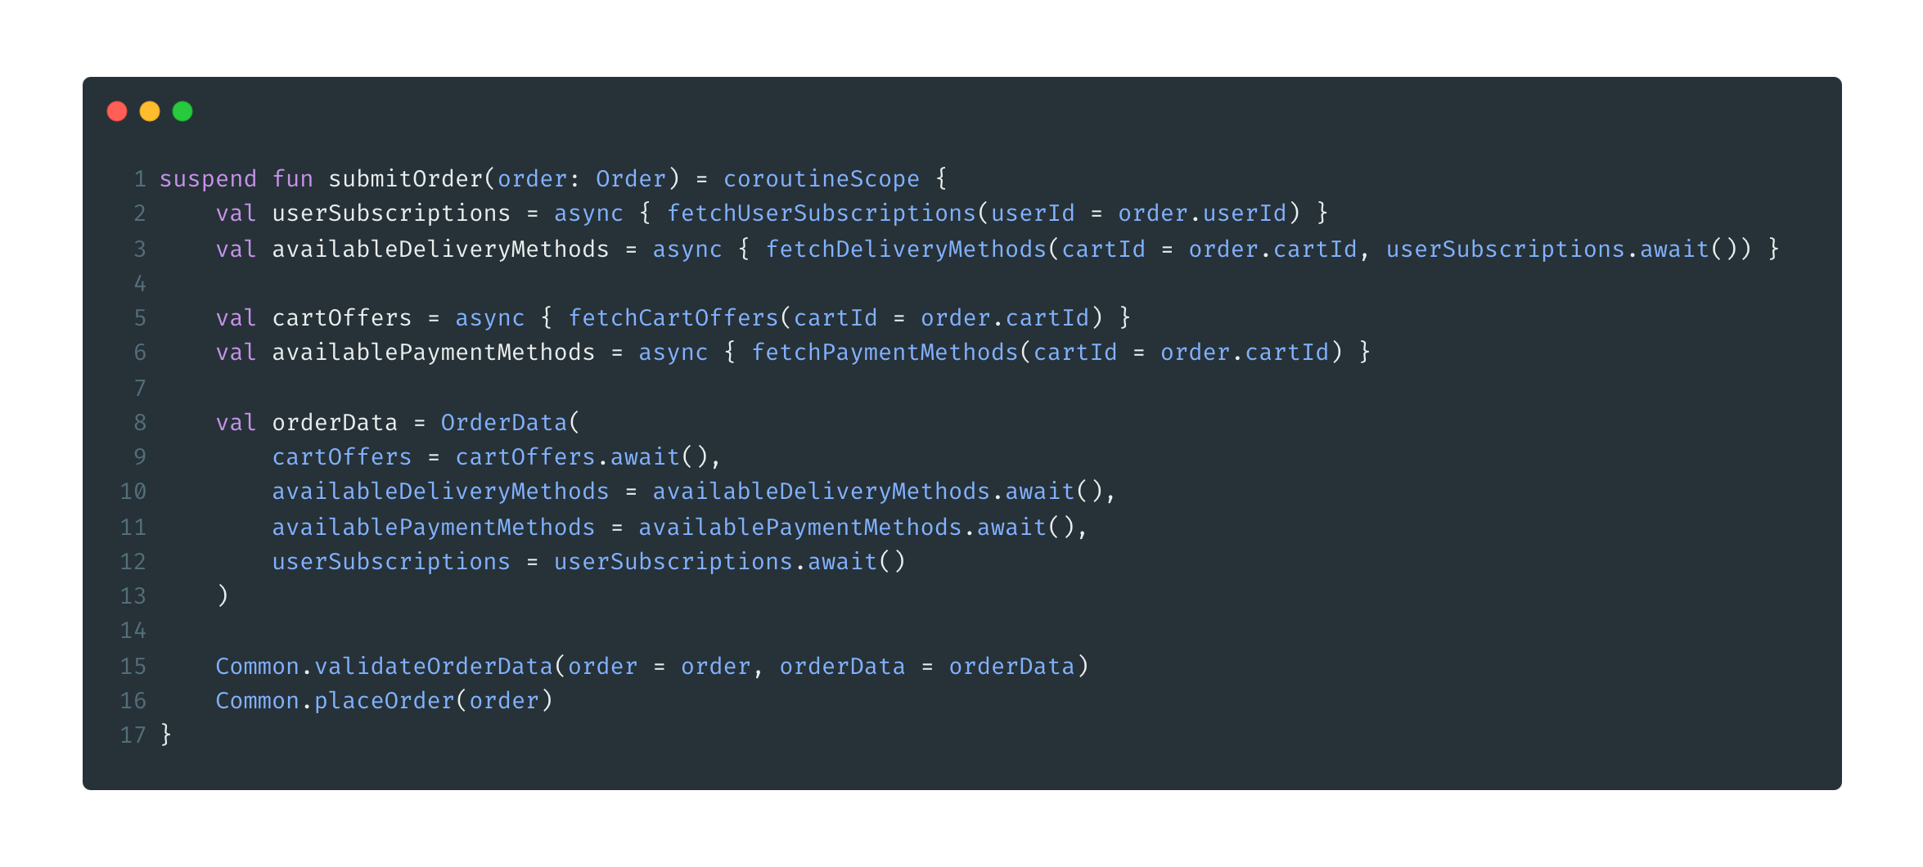
Coroutines solution

Slide 28
Coroutines solution
language built-in, ubiquitous API
flexible
minimum accidental complexity
asynchronous and concurrent APIs in one
has default and configurable cancelation mechanism
has default and configurable error handling mechanism

Slide 29
Coroutine definition
“A coroutine is an instance of a suspendable computation. It is conceptually similar to a thread, in the sense that it takes a block of code to run that works concurrently with the rest of the code. However, a coroutine is not bound to any particular thread. It may suspend its execution in one thread and resume in another one.”

Slide 30
Suspending function
What is suspending function?
- Function that can be suspended and resumed at some point in future
Requirements:
suspend function must be called by coroutine or by another suspending function
‘suspend’ keyword

Slide 31
Suspending function
Show code snippets from package ‘n1_suspendingfunction’

Slide 32
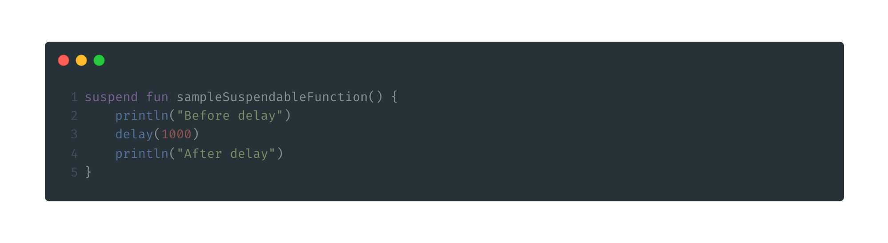
Suspension under the hood

Slide 33
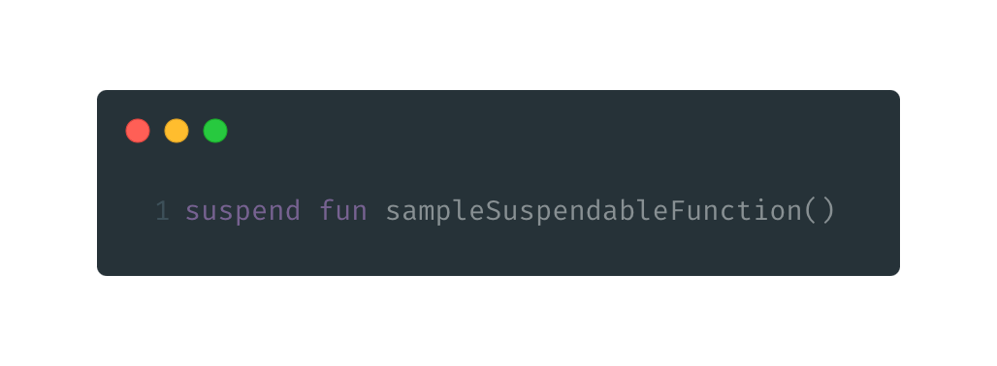
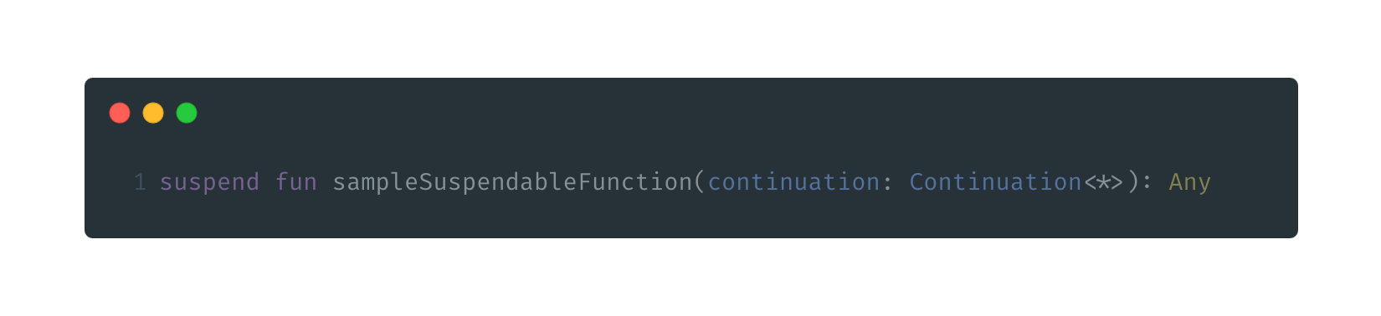
Suspension under the hood

Slide 34
Suspension under the hood
Continuation
is passed implicitly as a parameter from suspending function to suspending function
every suspending function has its own implementation of continuation that stores ALL parents continuations
allows to resume execution of suspended function
stores coroutine context (config)

Slide 35
Suspension under the hood
Show code snippets from package ‘n2_suth’

Slide 36
Suspension under the hood
What if function has state?

Slide 37
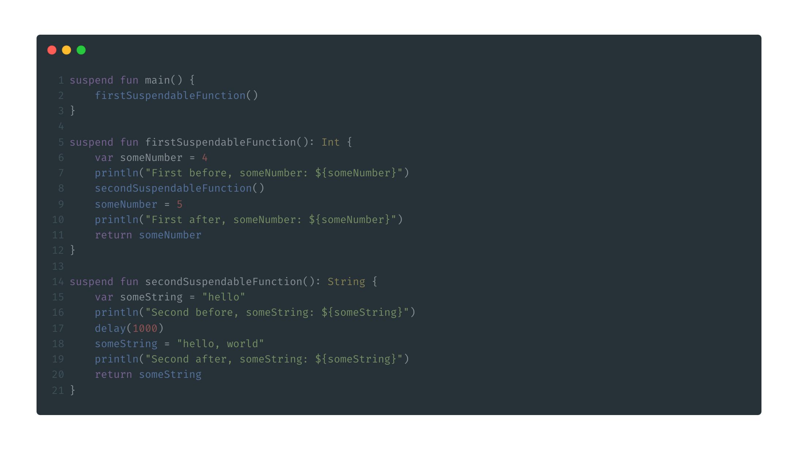
Suspension under the hood

Slide 38
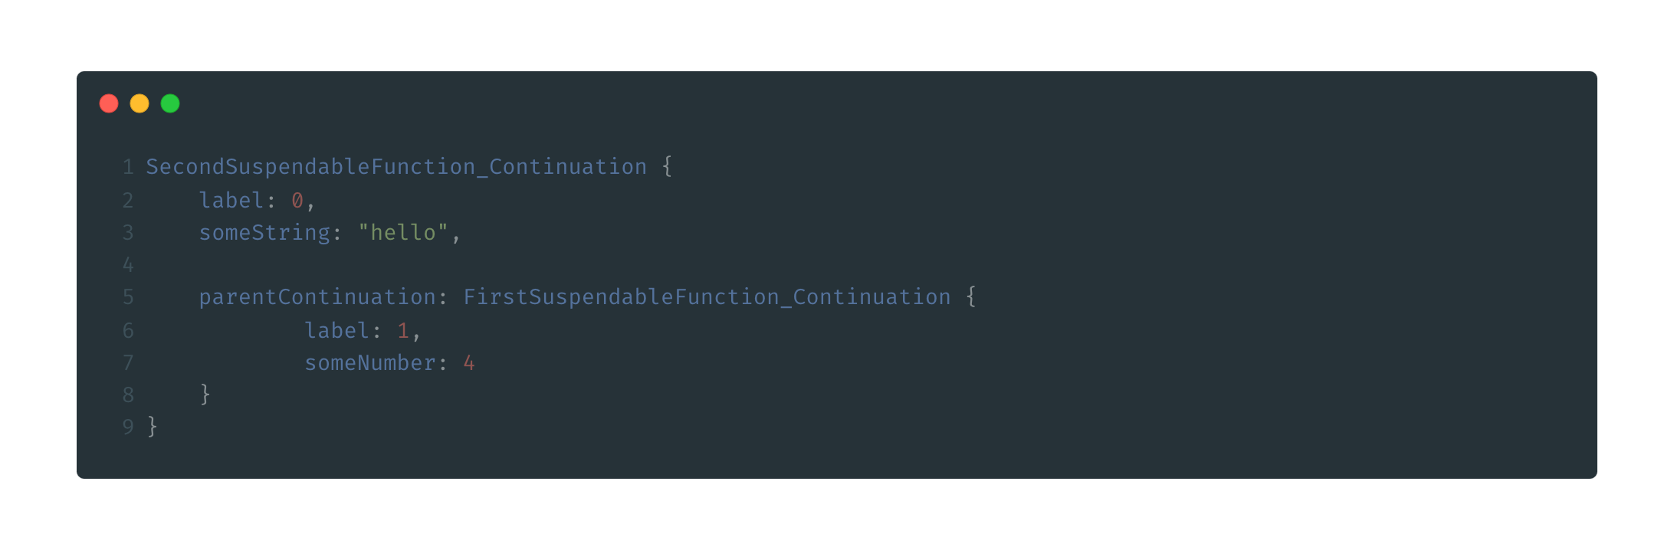
Suspension under the hood

Slide 39
Suspension under the hood
Suspending functions is kind of state machine with possible states before and after every suspension point
Continuation of current suspending function wraps parent’s continuation

Slide 40

Coroutine builders
Suspending function should be called only by another suspending function or by coroutine.
So, how to start a coroutine?
To start coroutine we need to use coroutine builder.
runBlocking, runTest
launch
async

Slide 41
Coroutine builders - launch/async
launch/async
extension function on the CoroutineScope interface (part of the mechanism called “structured concurrency”
similar to starting thread in daemon mode (threads_vs_launch.kt)
suspendCoroutine doesn’t block the thread, just suspends the coroutine

Slide 42
Coroutine builders - runBlocking
runBlocking
top level coroutine builder
provides coroutine scope for its children
blocks execution of the thread on which it was called

Slide 43
Coroutine builders
Every coroutine:
is started inside specific coroutine scope
has it’s own inherited coroutine context

Slide 44
Structured concurrency
`structured concurrency` - mechanism of building a relationships between the parent coroutine and a child coroutine. CoroutineScope defines the lifetime of the coroutine and its children.
Parent coroutine:
provides scope for its children;
parent suspends (not blocks!) until all the children are completed;
children inherit context (configurations) from their parents;
when the parent is cancelled, its children coroutines are cancelled as well;
when a child is destroyed it also destroys its parent;

Slide 45









Structured concurrency - animation
runBlocking
Coroutines pool
Block of some regular code
cor_1
launch_1
Block of some regular code
delay(1000)
Suspends coroutine for
1000 milliseconds
Block of some regular code
Block of some regular code
Threads pool
launch_2
Block of some regular code
main_th
delay(1000)
Suspends coroutine for
1000 milliseconds
Block of some regular code
Block of some regular code

Slide 46

Structured concurrency - animation
runBlocking
Coroutines pool
Block of some regular code
launch_1
Block of some regular code
delay(1000)
Suspends coroutine for
1000 milliseconds
Block of some regular code
Block of some regular code
Threads pool
launch_2
cor_1
Block of some regular code
main_th
delay(1000)
Suspends coroutine for
1000 milliseconds
Block of some regular code
Block of some regular code

Slide 47


Structured concurrency - animation
runBlocking
cor_1
Coroutines pool
main_th
Block of some regular code
launch_1
Block of some regular code
delay(1000)
Suspends coroutine for
1000 milliseconds
Block of some regular code
Block of some regular code
Threads pool
launch_2
Block of some regular code
delay(1000)
Suspends coroutine for
1000 milliseconds
Block of some regular code
Block of some regular code

Slide 48
Structured concurrency - animation
runBlocking
Coroutines pool
Block of some regular code
cor_1
cor_2
main_th
launch_1
Block of some regular code
delay(1000)
Suspends coroutine for
1000 milliseconds
Block of some regular code
Block of some regular code
Threads pool
launch_2
Block of some regular code
delay(1000)
Suspends coroutine for
1000 milliseconds
Block of some regular code
Block of some regular code

Slide 49

Structured concurrency - animation
runBlocking
Coroutines pool
Block of some regular code
cor_2
launch_1
Block of some regular code
delay(1000)
Suspends coroutine for
1000 milliseconds
Block of some regular code
cor_1
Block of some regular code
main_th
Threads pool
launch_2
Block of some regular code
delay(1000)
Suspends coroutine for
1000 milliseconds
Block of some regular code
Block of some regular code

Slide 50
Structured concurrency - animation
runBlocking
Coroutines pool
Block of some regular code
cor_2
launch_1
Block of some regular code
delay(1000)
Suspends coroutine for
1000 milliseconds
Block of some regular code
Block of some regular code
cor_1
Threads pool
main_th
launch_2
cor_3
Block of some regular code
delay(1000)
Suspends coroutine for
1000 milliseconds
Block of some regular code
Block of some regular code

Slide 51

Structured concurrency - animation
runBlocking
Coroutines pool
Block of some regular code
cor_2
launch_1
Block of some regular code
cor_3
delay(1000)
Suspends coroutine for
1000 milliseconds
Block of some regular code
Block of some regular code
Threads pool
launch_2
Block of some regular code
delay(1000)
Suspends coroutine for
1000 milliseconds
Block of some regular code
cor_1
Block of some regular code
main_th

Slide 52
Structured concurrency - animation
runBlocking
Coroutines pool
Block of some regular code
cor_2
launch_1
Block of some regular code
cor_3
delay(1000)
Suspends coroutine for
1000 milliseconds
Block of some regular code
Block of some regular code
cor_1
main_th
Threads pool
launch_2
Block of some regular code
delay(1000)
Suspends coroutine for
1000 milliseconds
Block of some regular code
Block of some regular code

Slide 53


Structured concurrency - animation
runBlocking
Coroutines pool
Block of some regular code
cor_2
cor_1
launch_1
Block of some regular code
cor_3
delay(1000)
Suspends coroutine for
1000 milliseconds
Block of some regular code
Block of some regular code
Threads pool
launch_2
Block of some regular code
main_th
delay(1000)
Suspends coroutine for
1000 milliseconds
Block of some regular code
Block of some regular code

Slide 54

Structured concurrency - animation
runBlocking
Coroutines pool
Block of some regular code
cor_1
launch_1
Block of some regular code
cor_3
delay(1000)
Suspends coroutine for
1000 milliseconds
Block of some regular code
Block of some regular code
Threads pool
launch_2
cor_2
Block of some regular code
main_th
delay(1000)
Suspends coroutine for
1000 milliseconds
Block of some regular code
Block of some regular code

Slide 55


Structured concurrency - animation
runBlocking
Coroutines pool
Block of some regular code
cor_1
cor_2
launch_1
main_th
Block of some regular code
cor_3
delay(1000)
Suspends coroutine for
1000 milliseconds
Block of some regular code
Block of some regular code
Threads pool
launch_2
Block of some regular code
delay(1000)
Suspends coroutine for
1000 milliseconds
Block of some regular code
Block of some regular code

Slide 56
Structured concurrency - animation
runBlocking
Coroutines pool
Block of some regular code
cor_1
launch_1
Block of some regular code
cor_2
cor_3
main_th
delay(1000)
Suspends coroutine for
1000 milliseconds
Block of some regular code
Block of some regular code
Threads pool
launch_2
Block of some regular code
delay(1000)
Suspends coroutine for
1000 milliseconds
Block of some regular code
Block of some regular code

Slide 57
Structured concurrency - animation
runBlocking
Coroutines pool
Block of some regular code
cor_1
launch_1
Block of some regular code
cor_2
cor_3
delay(1000)
main_th
Suspends coroutine for
1000 milliseconds
Block of some regular code
Block of some regular code
Threads pool
launch_2
Block of some regular code
delay(1000)
Suspends coroutine for
1000 milliseconds
Block of some regular code
Block of some regular code

Slide 58
Structured concurrency - animation
runBlocking
Coroutines pool
Block of some regular code
cor_2
cor_1
launch_1
Block of some regular code
cor_3
delay(1000)
Suspends coroutine for
1000 milliseconds
Block of some regular code
Block of some regular code
Threads pool
launch_2
Block of some regular code
main_th
delay(1000)
Suspends coroutine for
1000 milliseconds
Block of some regular code
Block of some regular code

Slide 59
Structured concurrency - animation
runBlocking
Coroutines pool
Block of some regular code
cor_2
cor_1
launch_1
Block of some regular code
delay(1000)
Suspends coroutine for
1000 milliseconds
Block of some regular code
Block of some regular code
cor_3
main_th
Threads pool
launch_2
Block of some regular code
delay(1000)
Suspends coroutine for
1000 milliseconds
Block of some regular code
Block of some regular code

Slide 60
Structured concurrency - animation
runBlocking
Coroutines pool
Block of some regular code
cor_2
cor_1
launch_1
Block of some regular code
delay(1000)
Suspends coroutine for
1000 milliseconds
Block of some regular code
Block of some regular code
Threads pool
cor_3
launch_2
main_th
Block of some regular code
delay(1000)
Suspends coroutine for
1000 milliseconds
Block of some regular code
Block of some regular code

Slide 61
Structured concurrency - animation
runBlocking
Coroutines pool
Block of some regular code
cor_2
cor_1
launch_1
Block of some regular code
delay(1000)
Suspends coroutine for
1000 milliseconds
Block of some regular code
Block of some regular code
Threads pool
launch_2
Block of some regular code
cor_3
main_th
delay(1000)
Suspends coroutine for
1000 milliseconds
Block of some regular code
Block of some regular code

Slide 62
Structured concurrency - animation
runBlocking
Coroutines pool
Block of some regular code
cor_2
cor_1
launch_1
Block of some regular code
cor_3
delay(1000)
Suspends coroutine for
1000 milliseconds
Block of some regular code
Block of some regular code
Threads pool
launch_2
Block of some regular code
main_th
delay(1000)
Suspends coroutine for
1000 milliseconds
Block of some regular code
Block of some regular code

Slide 63
Structured concurrency - animation
runBlocking
Coroutines pool
Block of some regular code
cor_2
cor_1
launch_1
Block of some regular code
cor_3
delay(1000)
Suspends coroutine for
1000 milliseconds
Block of some regular code
Block of some regular code
Threads pool
launch_2
Block of some regular code
main_th
delay(1000)
Suspends coroutine for
1000 milliseconds
Block of some regular code
Block of some regular code

Slide 64
Structured concurrency - animation
runBlocking
Coroutines pool
Block of some regular code
cor_2
cor_1
launch_1
Block of some regular code
cor_3
delay(1000)
Suspends coroutine for
1000 milliseconds
Block of some regular code
Block of some regular code
Threads pool
launch_2
Block of some regular code
main_th
delay(1000)
Suspends coroutine for
1000 milliseconds
Block of some regular code
Block of some regular code

Slide 65
Structured concurrency - animation
runBlocking
Coroutines pool
Block of some regular code
cor_1
launch_1
Block of some regular code
cor_3
delay(1000)
Suspends coroutine for
1000 milliseconds
cor_2
main_th
Block of some regular code
Block of some regular code
Threads pool
launch_2
Block of some regular code
delay(1000)
Suspends coroutine for
1000 milliseconds
Block of some regular code
Block of some regular code

Slide 66


Structured concurrency - animation
runBlocking
Coroutines pool
Block of some regular code
cor_2
cor_1
launch_1
Block of some regular code
cor_3
delay(1000)
Suspends coroutine for
1000 milliseconds
Block of some regular code
Block of some regular code
Threads pool
launch_2
Block of some regular code
main_th
delay(1000)
Suspends coroutine for
1000 milliseconds
Block of some regular code
Block of some regular code

Slide 67
Structured concurrency - animation
runBlocking
Coroutines pool
Block of some regular code
cor_2
cor_1
launch_1
Block of some regular code
cor_3
delay(1000)
Suspends coroutine for
1000 milliseconds
Block of some regular code
Block of some regular code
Threads pool
launch_2
Block of some regular code
main_th
delay(1000)
Suspends coroutine for
1000 milliseconds
Block of some regular code
Block of some regular code

Slide 68
Structured concurrency - animation
runBlocking
Coroutines pool
Block of some regular code
cor_2
cor_1
launch_1
Block of some regular code
cor_3
delay(1000)
Suspends coroutine for
1000 milliseconds
Block of some regular code
Block of some regular code
Threads pool
launch_2
Block of some regular code
main_th
delay(1000)
Suspends coroutine for
1000 milliseconds
Block of some regular code
Block of some regular code

Slide 69
Structured concurrency - animation
runBlocking
Coroutines pool
Block of some regular code
cor_2
cor_1
launch_1
Block of some regular code
delay(1000)
Suspends coroutine for
1000 milliseconds
Block of some regular code
Block of some regular code
Threads pool
launch_2
Block of some regular code
delay(1000)
Suspends coroutine for
1000 milliseconds
cor_3
main_th
Block of some regular code
Block of some regular code

Slide 70

Structured concurrency - animation
runBlocking
Coroutines pool
Block of some regular code
cor_2
cor_1
launch_1
Block of some regular code
cor_3
delay(1000)
Suspends coroutine for
1000 milliseconds
Block of some regular code
Block of some regular code
Threads pool
launch_2
Block of some regular code
main_th
delay(1000)
Suspends coroutine for
1000 milliseconds
Block of some regular code
Block of some regular code

Slide 71

Structured concurrency - animation
runBlocking
Coroutines pool
Block of some regular code
cor_2
cor_1
launch_1
Block of some regular code
cor_3
delay(1000)
Suspends coroutine for
1000 milliseconds
Block of some regular code
Block of some regular code
Threads pool
launch_2
Block of some regular code
main_th
delay(1000)
Suspends coroutine for
1000 milliseconds
Block of some regular code
Block of some regular code

Slide 72
Coroutine definition
“A coroutine is an instance of a suspendable computation. It is conceptually similar to a thread, in the sense that it takes a block of code to run that works concurrently with the rest of the code. However, a coroutine is not bound to any particular thread. It may suspend its execution in one thread and resume in another one.”

Slide 73
CoroutineContext
CoroutineContext - is a collection (set) of unique coroutine configurations. Every element is separate instance of configuration.
CoroutineContext:
inherited by coroutine from its parents
can be overridden
passed by suspending function inside
coroutineContext is available inside every suspending function
Analog of ThreadLocal in coroutine context
Example context implementation:
Job
Dispatchers
CoroutineExceptionHandler
coroutine context → defaultContext + parentContext + childContext

Slide 74
CoroutineContext - Job
Job is an implementation of CoroutineContext that responsible for handling coroutine lifecycle.
Job is the only context that is not inherited.
Every coroutine has it’s own Job instance that has reference to the parent of current coroutine and all children of current coroutine

Slide 75
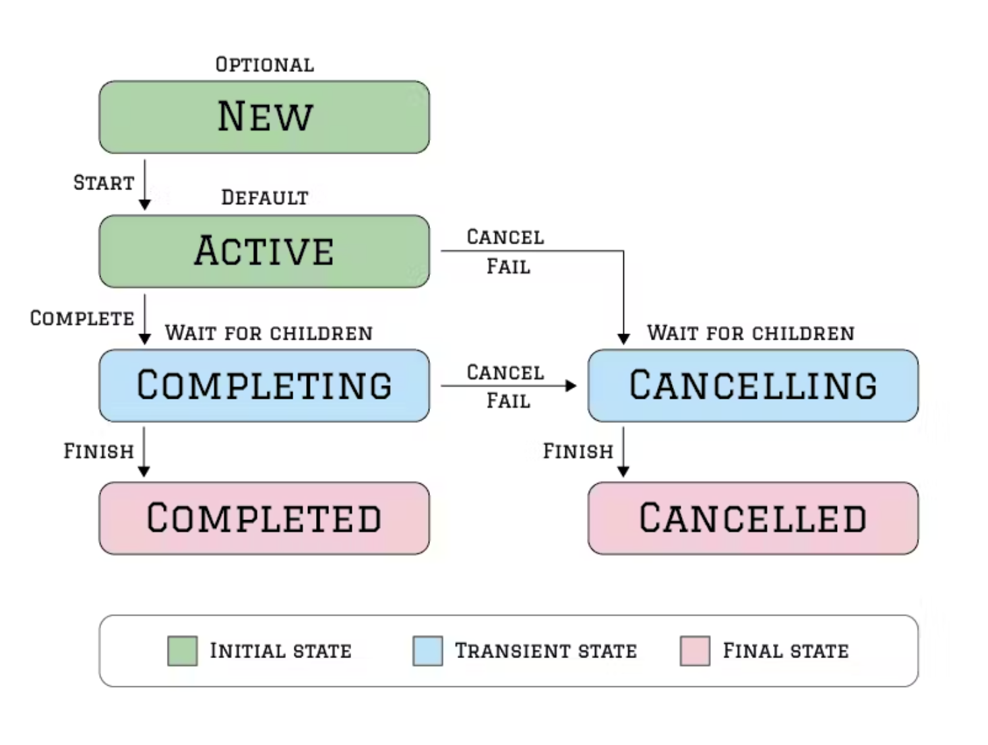
CoroutineContext - Job
Source: https://maxkim.eu/things-every-kotlin-developer-should-know-about-coroutines-part-4-exception-handling

Slide 76
Cancellation
Cancelled coroutine ends on first suspension point.
Children of suspend coroutine also cancelled.
Parent coroutine is not effected.
Coroutine is cancelled by throwing CancellationException
To clean up:
invokeOnCompletion
suspendCancellableCoroutine.invokeOnCancellation
ensureActive, yield

Slide 77
Exception handling
Broken coroutine:
Cancel all its children
Propagates error to parent coroutine

Slide 78
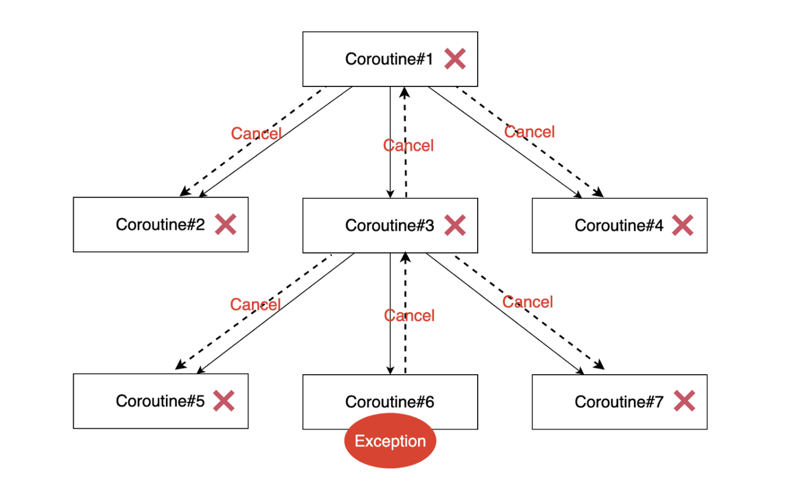
Exception handling
Source: https://icarus8050.tistory.com/151

Slide 79
Exception handling
To stop breaking
use CancellationException
SuperviserJob
CoroutineExceptionHandler
superviserScope
coroutineScope

Slide 80
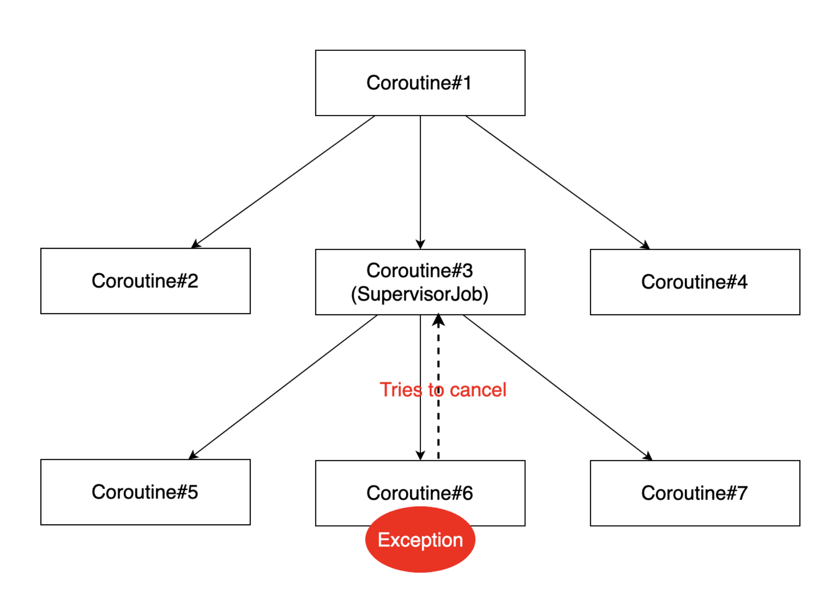
Exception handling
Source: https://icarus8050.tistory.com/151

Slide 81
Coroutine scope functions
Coroutine scope functions:
create an environment where you can launch one or more coroutines and ensure they don't linger on after the block completes.
provide CoroutineScope inside suspended function that inherits CoroutineContext from it’s parent
Examples:
coroutineScope
supervisorScope
withContext
withTimeout

Slide 82


Slide 83


Slide 84

Thank you for your attention!

